Slide 1
Making Color
Violet

Slide 2
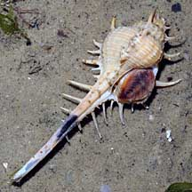
Tyrian purple
Extracted from glands. American species have glands close to surface; can be squeezed and replaced in water alive. But Mediterranean species needs to be crushed to release pigment.
Chemically related to indigo; needs to be processed as dye in alkaline solution (mix of seawater, wood ash, fermented urine, or lime-water). Yields purple with exposure to oxygen.
Dyeing a robe, cloak, mantle, toga or other garment that weighed only a kilogram (2.2 lb) to a deep shade would require not fewer than 10,000 snails.
Philippa Scott, “Millennia of Murex,” Saudi Aramco World, July/Aug 2006

Slide 3
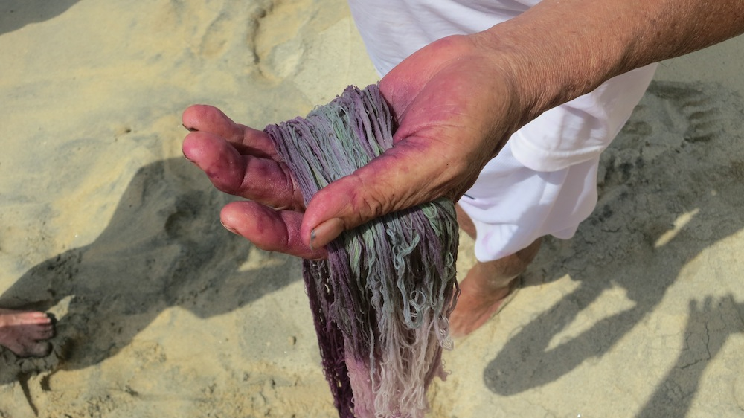
Oxidization

Slide 4
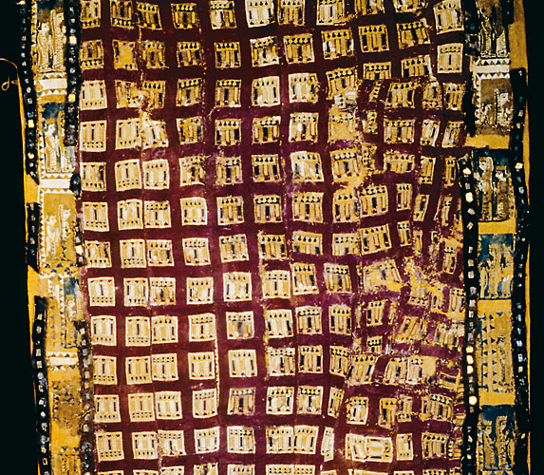
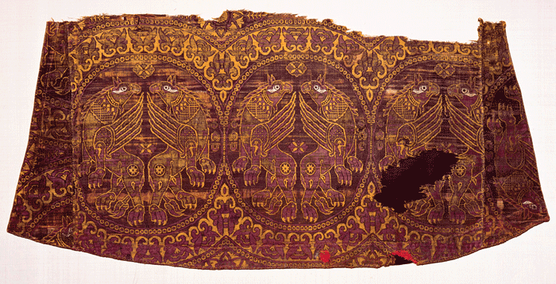
5th c. Persian tapestry
11th c. Byzantine robe

