Slide 1
Making color
Reds

Slide 2
Mordant: metallic substance used to fix dye by making it insoluble

Slide 3
Madder
Oldest known dye substance globally
Root of Rubia Tinctoria
Red lake
Entire medieval European towns had economies based on use of madder in textiles
Needs to be cooked at low temp for at least 12 hours
Not a rich red and can fade to orange

Slide 4
Kermes
Ancient dye, used by Romans and Middle Eastern societies
Found around Mediterranean on oak trees
14th c. account keeper in Constantinople writes that a good slave is worth half a pound of kermes
Used for Cardinals’ robes
Provided crimsons and scarlets

Slide 5
Cochineal
Introduced into Europe by Spanish conquerors of Mexico in 16th c., who had a monopoly on it
Used by Incas and Aztecs in ceremonies and manuscripts
Lives on cactus
Replaces use of kermes
Only decreased in value in 19th c., with synthetic reds
E120 in foodstuffs

Slide 6
Mexican cochineal

Slide 7
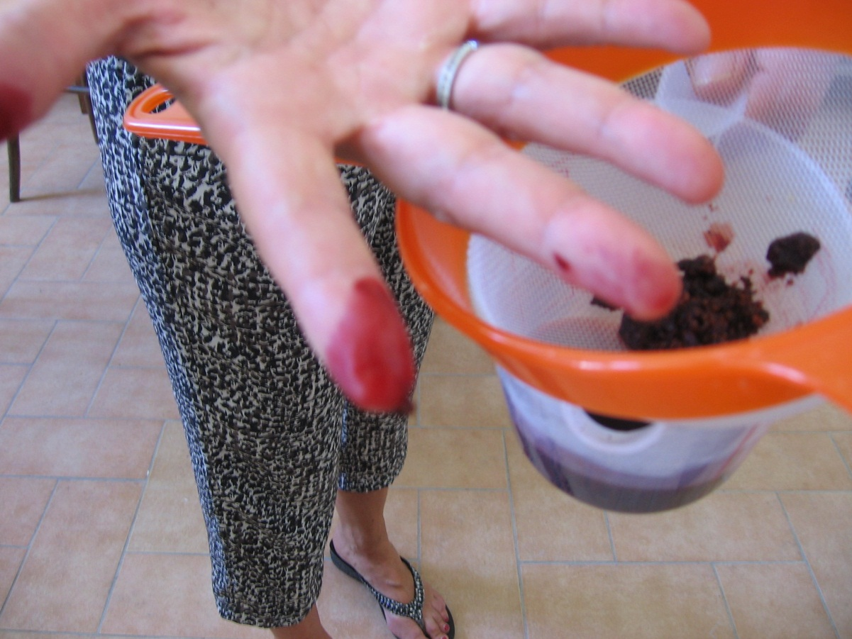

Slide 8
Indian lac

