Slide 1
Making Color
Indigo

Slide 2
History of production
Indus Valley cultivation 3rd millennium BCE
Babylonian dye recipes 7th c. BCE
European trade for 16th c.
European monopoly on woad 16th-17thc.
French and Dutch through West India Company (slave labor) rivals British East India Company
Riots in Bengal 1860s (nil darpan play)
https://www.youtube.com/watch?v=tGReWNXLqro (movie from 1952)
Exported from Carolinas 18th c.

Slide 3
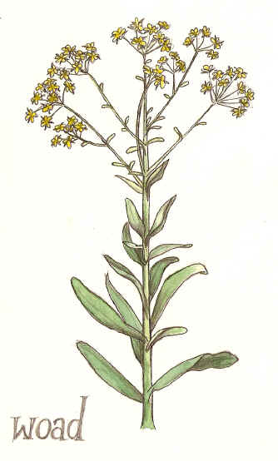
Indigotin (principle ingredient in blue-producing plants)
Waod is only indigotin producing plant native to Europe (Germany, Northern Italy, France)
Also used for producing green and black dyes
Waste from dye works contaminate water supplies and odor requires keeping away from residential areas

Slide 4
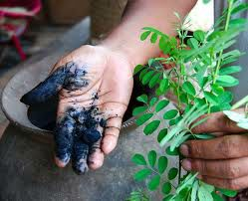
Indigo as dye
Most difficult of dyes, requires vat with oxygen removed
Picked in beginning of summer (flowers in second year), macerated with wheel then left to dry in sun which intensifies indigo content (4 weeks)
Resulting tar-like substance needs to be dissolved through fermentation (30 hours temp 80-100 degrees and kept alkaline). Tested repeatedly for smell and taste, an hour too late will ruin dye.
Color does not appear until water is whipped to introduce oxygen(picking up oxygen changes dye to pigment and traps in material, doesn’t fade in sun but can be abraded-jeans!)
Mud at bottom of vats is filtered through linen and dried in cakes.

Slide 5
Making indigo dye
Process: https://www.youtube.com/watch?v=UEMcjmyjoOY
Dyeing: https://www.youtube.com/watch?v=hes05oYzd6c

