Slide 1
Making Color
Greens

Slide 2
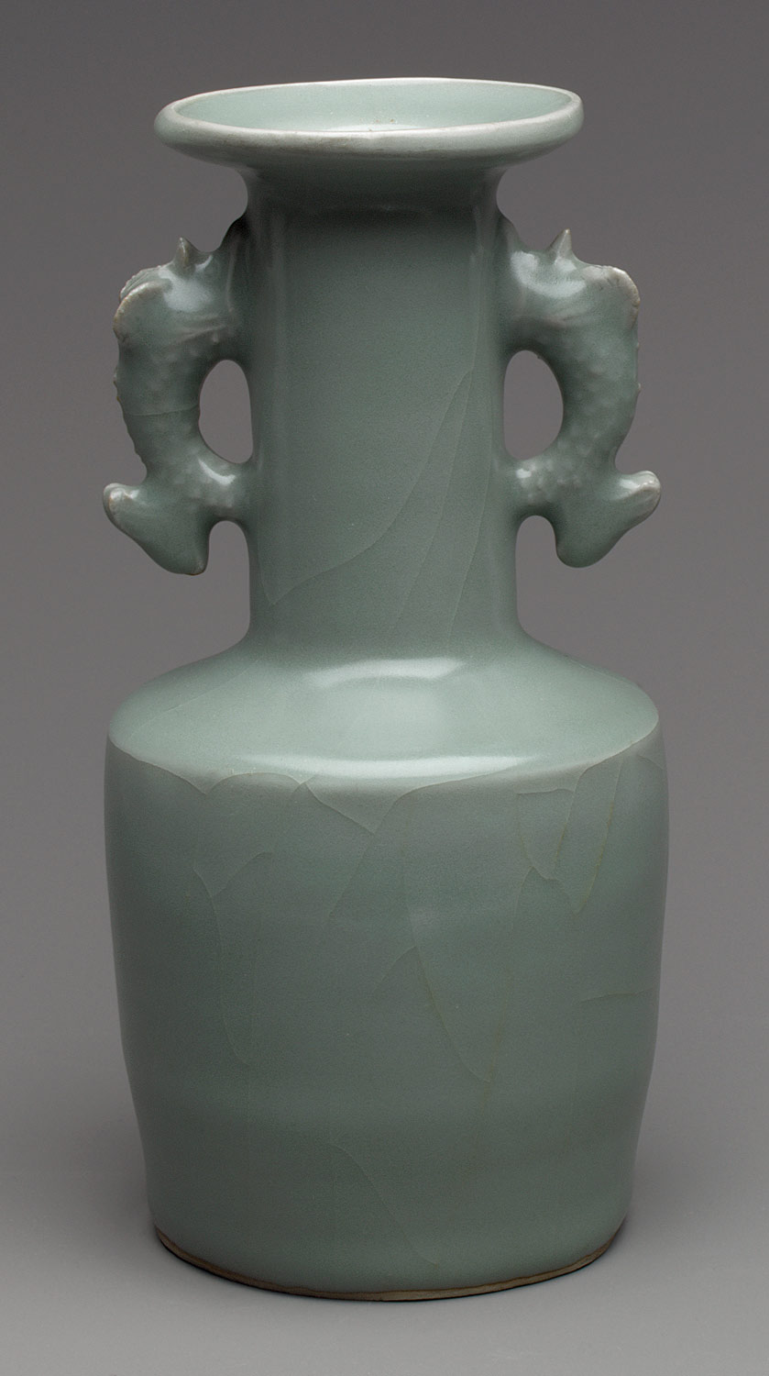
Celadon/mi se
Metropolitan Museum
Period: Southern Song dynasty (1127–1279)
Date: 12th–13th century
Culture: China
Medium: Porcelain with relief decoration under celadon glaze (Longquan ware) Accession Number: 50.145.301

Slide 3
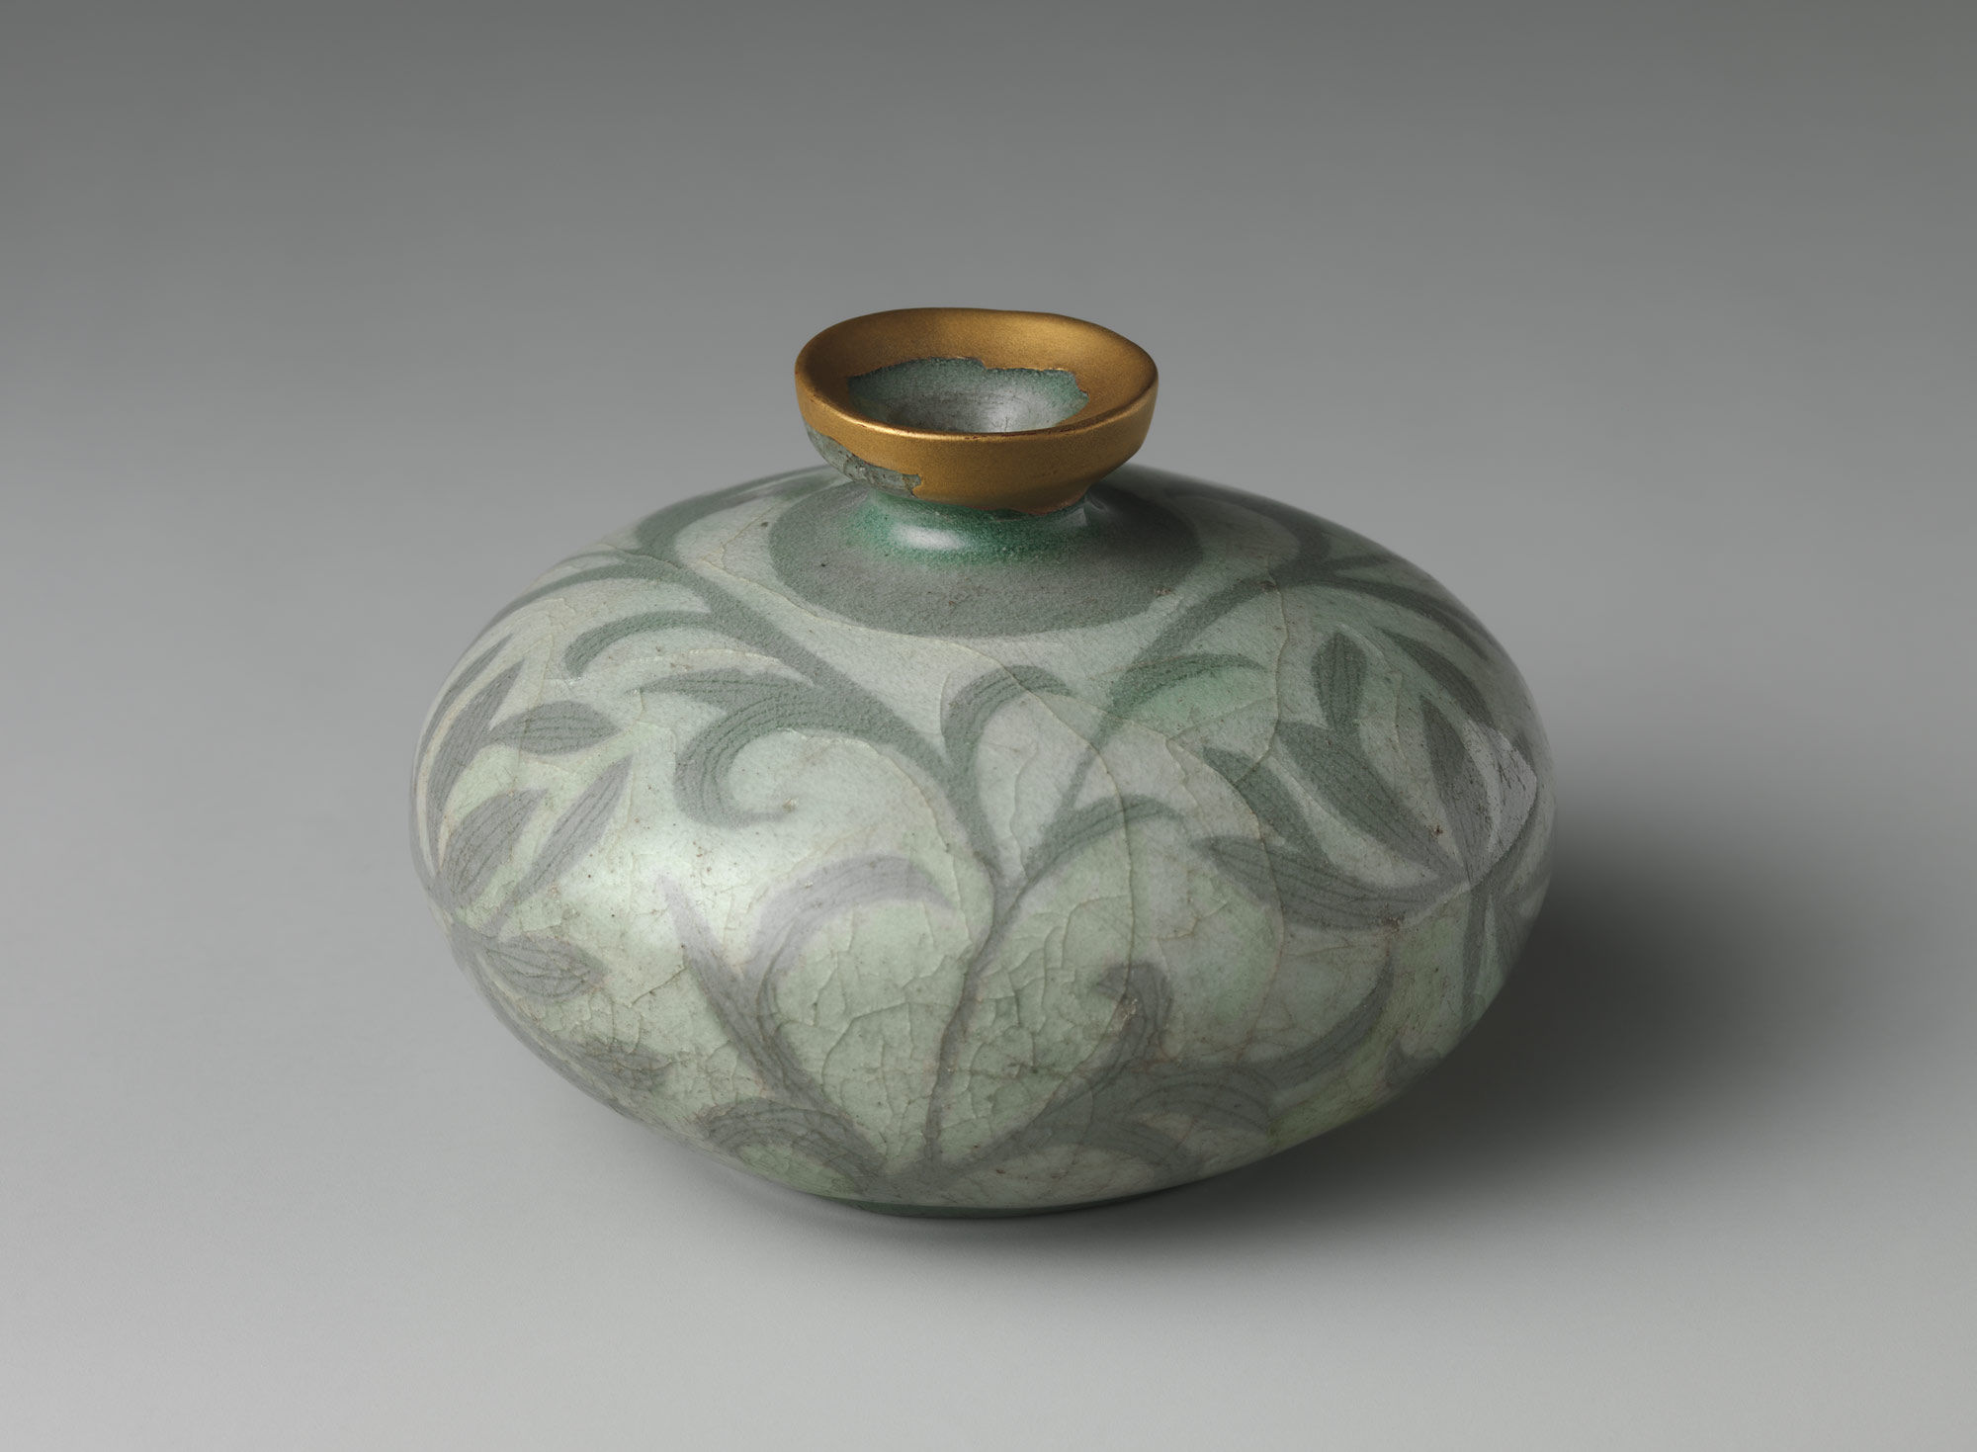
Metropolitan Museum
Oil bottle decorated with peony leaves
Period: Goryeo dynasty (918–1392)
Date: late 12th century
Culture: Korea
Medium: Stoneware with reverse-inlaid design under celadon glaze
Accession Number: 17.175.9

Slide 4
Malachite
Hydrated form of azurite (church ceilings in Italy, moisture in air turns azurite into malachite)
Used in medieval murals and paintings

Slide 5
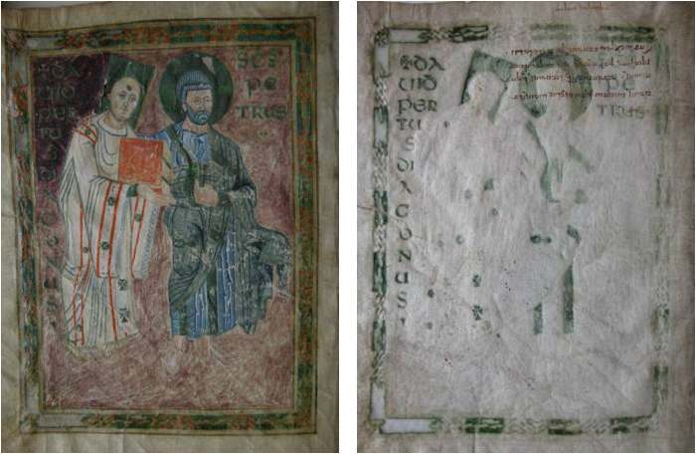
Verdigris
Made by treating copper with acetate (usually vinegar): suspend copper piece over vinegar in sealed jar; scrape pigment off and mix with wine to thicken.
Can eat through support

Slide 6
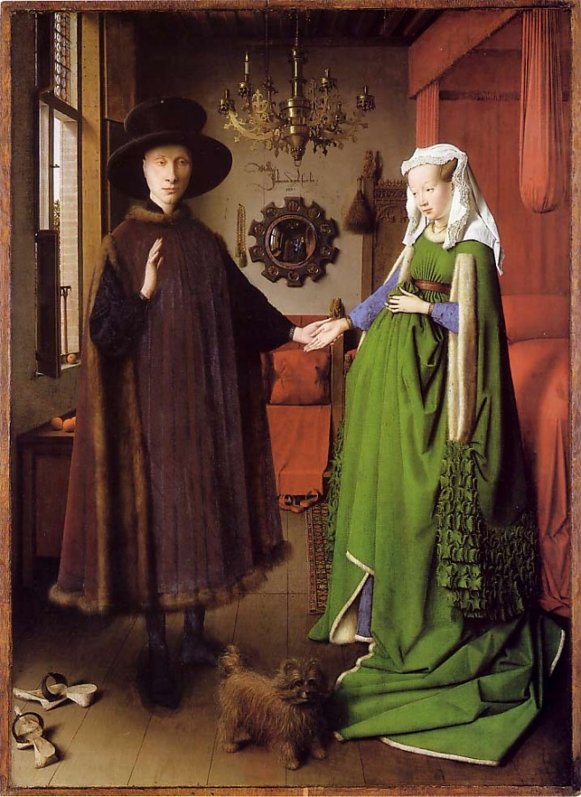
Jan van Eyck, The Arnolfini Marriage
1434
National Gallery, London

Slide 7
Buckthorn/Persian Berry/Sap green
Found in scrub and woodland with best source in Persia
Both berries are used (for yellow and green) and bark (for green)

