Slide 1
Making Color
Blues

Slide 2
Azurite/blue verdigris
Used in medieval paints from 9thc.
Deposits in Italy, Czech Republic, Hungary
Easy to prepare and difficult to distinguish from ultramarine by eye
Expensive, after lapis lazuli and gold

Slide 3
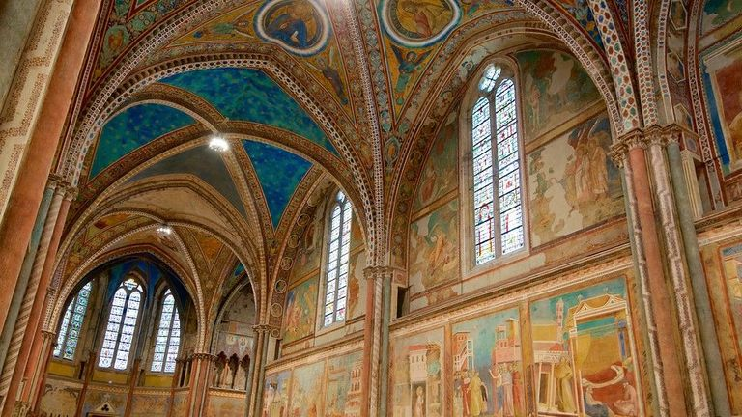
Basilica of Saint Francis, Assisi

Slide 4
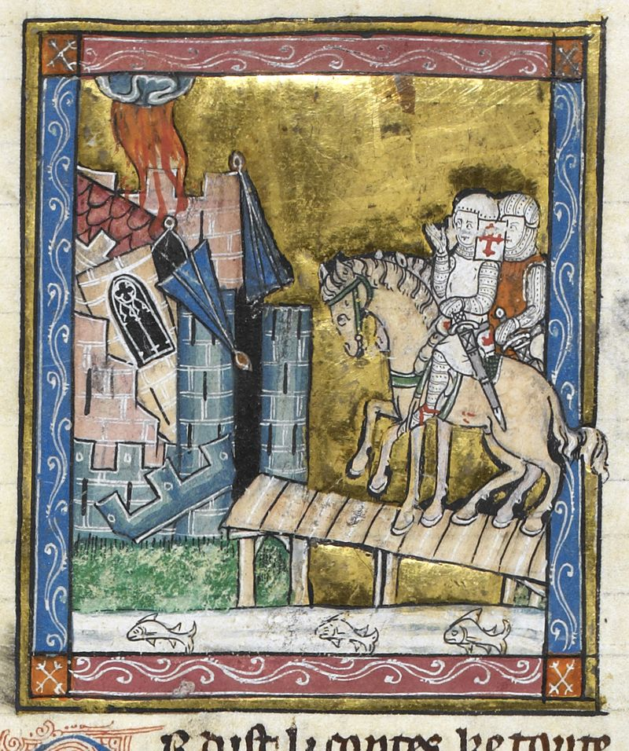
Detail of a miniature of Sir Galahad and his companions on the Quest for the Holy Grail
c. 1315-1325 (London, British Library, MS Royal 14 E. iii, f. 133v).

Slide 5
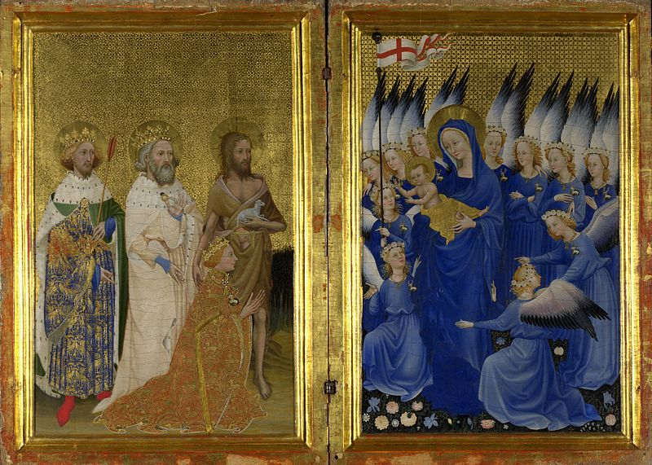
Wilton Diptych
c. 1400
National Gallery, London

Slide 6
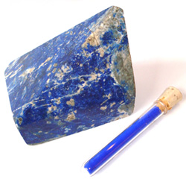
Lapis Lazuli/Ultramarine (Across the Sea)
Found in cave paintings in Uzbekistan 6th-7th c.
Rare in European ancient and medieval art until changes in trade 12th-13th c. and availability of ultramarine
Until 15th c., available only from Badakhshan, Afghanistan. Since then, mines discovered in Chile, Zambia, and Siberia.
Difficult to prepare: powdered then mixed with linseed oil, wax, and gum
Complex chemical structure, could not be reproduced in lab until 19th c (French Ultramarine)
Most glamorous pigment on medieval color market, used for Mary’s robes and Christ’s eyes

Slide 7
Making ultramarine
https://www.youtube.com/watch?v=JBzEAt_ynvc

Slide 8
Cobalt
Mineral used in glazes until modern creation of pigment in 1802
Uncertain whether first made in Iran or China
Iran-Chinese trade in “blue and white ware” peaks in 14th c.

Slide 9
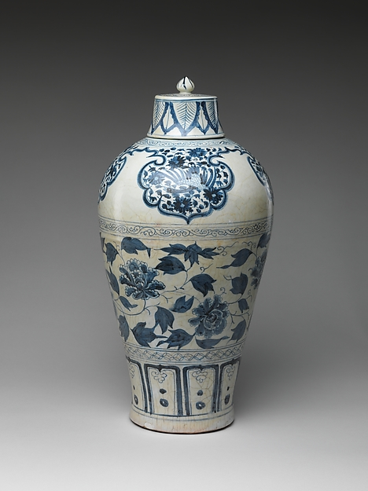
mid-14th century. Chinese, Yuan dynasty (1271–1368). Porcelain painted with cobalt blue under a transparent glaze (Jingdezhen ware
The Metropolitan Museum of Art

Slide 10
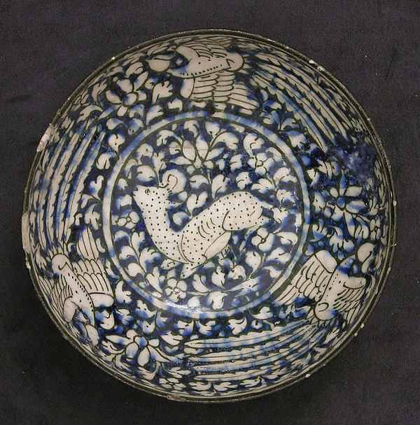
first half 14th century
Attributed to Iran, probably Kashan
Medium:
Stonepaste; blue and black painted under transparent glaze (Sultanabad ware)
Accession Number:
1970.27
Metropolitan Museum

